Slide 1



Predictive Modeling for Product Pricing on Amazon
Sruthi Pappu
Amogh Vig
Imran Mohammed
Notes:
Sruthi

Slide 2
01
Problem Statement
02
Exploratory Data Analysis
03
Feature Engineering
04
Overview of Modeling Pipelines Explored
Outline
05
Experimental results
06
Key Findings
07
Conclusion and Next Steps
08
Open issues or problems
Notes:
Sruthi

Slide 3
Problem Statement
Amazon is the largest online retailer in the world
Advanced predictive model using Amazon Reviews 2023 dataset
Predicts product prices based on features found on Amazon (product description, product rating, etc.)
The project aims to provide insights into pricing strategies for sellers and assist buyers in making informed decisions.
The ultimate objective is to optimize pricing for both sellers and buyers, improving the overall e-commerce experience.

Slide 4
Project Description
The goal is to develop a machine learning model to predict the price of products listed on Amazon.
The model will utilize features such as category, brand, and specifications to make predictions.
Regression techniques like linear regression, random forest, and XGBoost will be employed.
The project aims to provide insights into pricing strategies for sellers and assist buyers in making informed decisions.
The ultimate objective is to optimize pricing for both sellers and buyers, improving the overall e-commerce experience.

Slide 5
Exploratory Data Analysis
From Huggingface
Started with both review metadata and user review data
277 GB
Later focused on the metadata
58 GB
User review data contained information about the review, not product
Contained information about price, rating, category, store, description, etc.

Slide 6
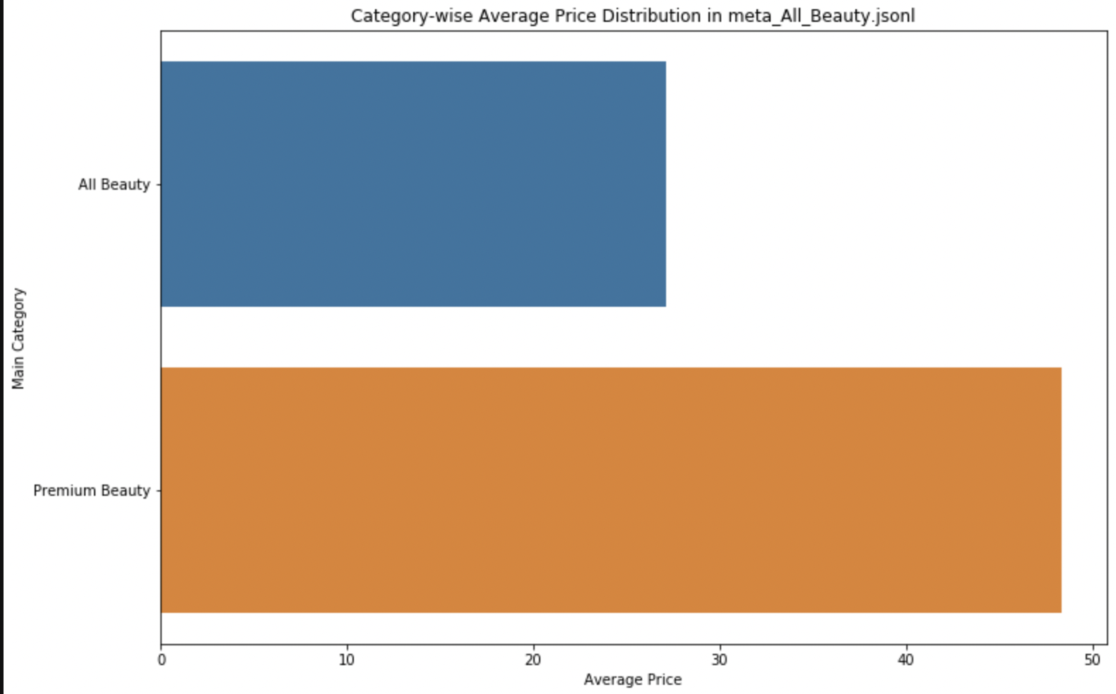
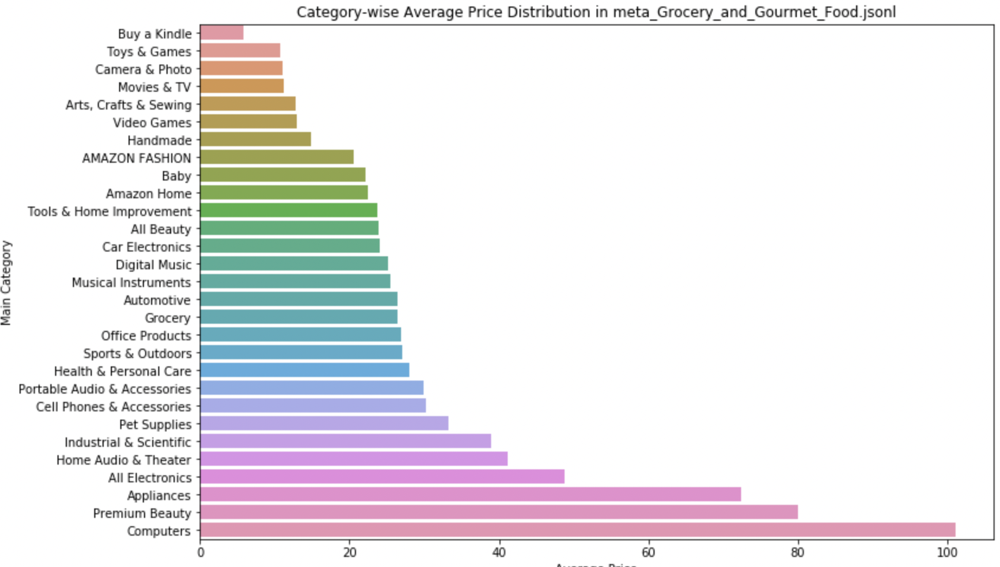
Exploratory Data Analysis

Slide 7
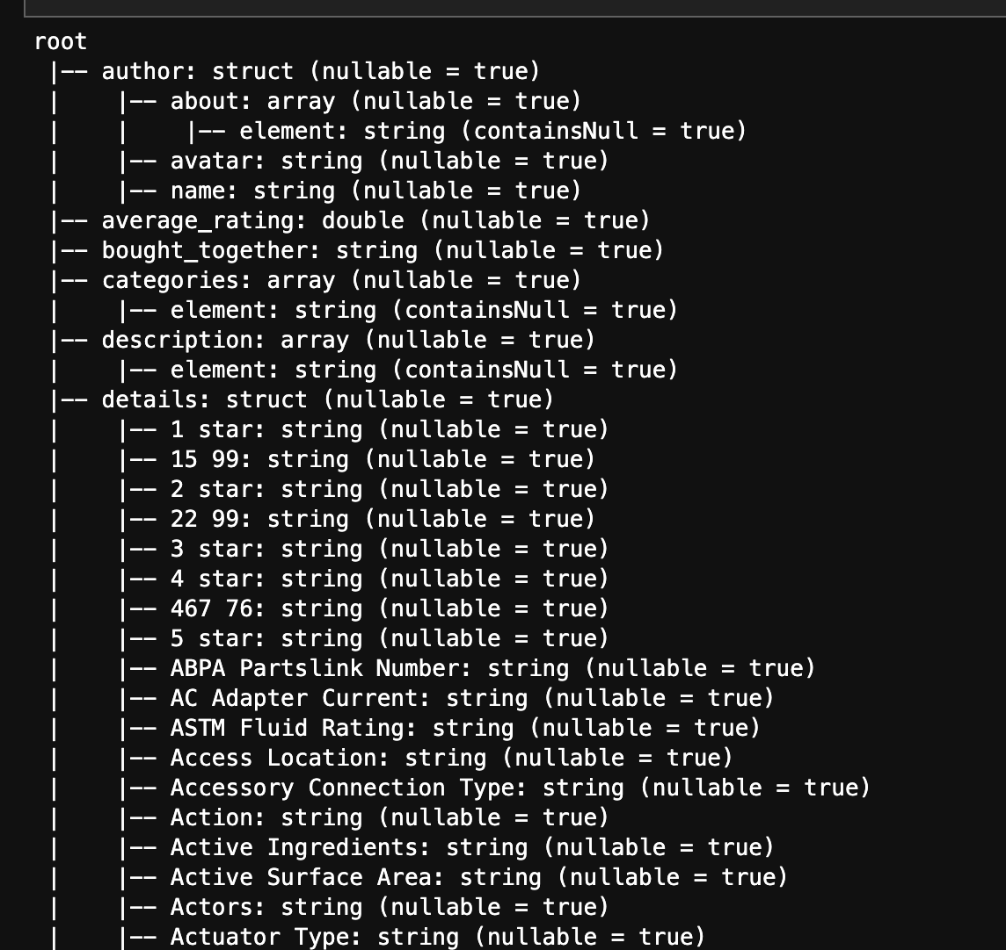
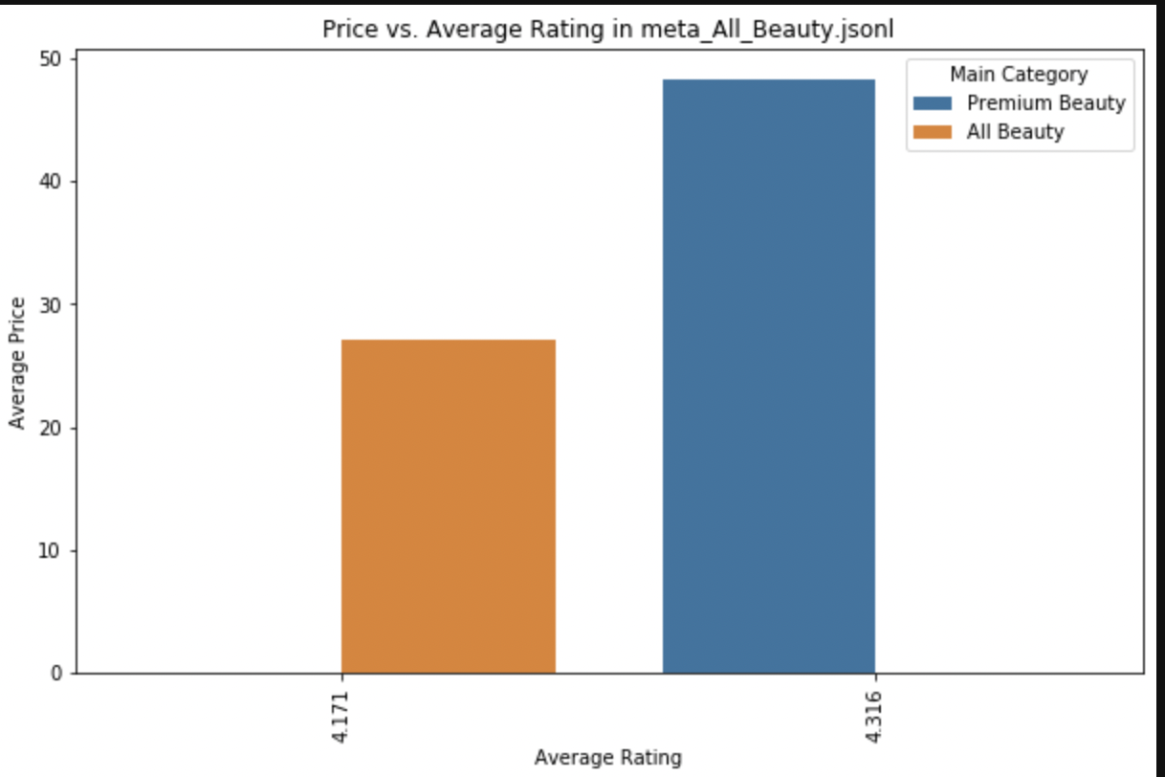
Exploratory Data Analysis

Slide 8

Feature Engineering
A number of columns were completely empty for certain categories, i.e. bought_together
Dropped
Certain columns were not compatible or important, i.e. Images, videos, ID
Dropped
Lots of null values in the price column and dataset
Dropped

Slide 9
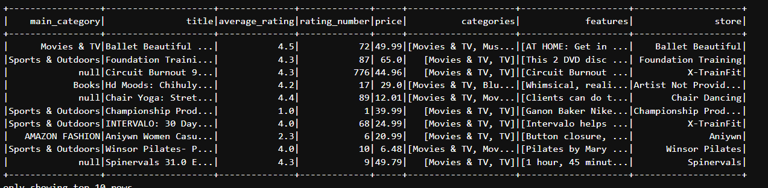
Feature Engineering
Final df contained both numerical values and string values

Slide 10
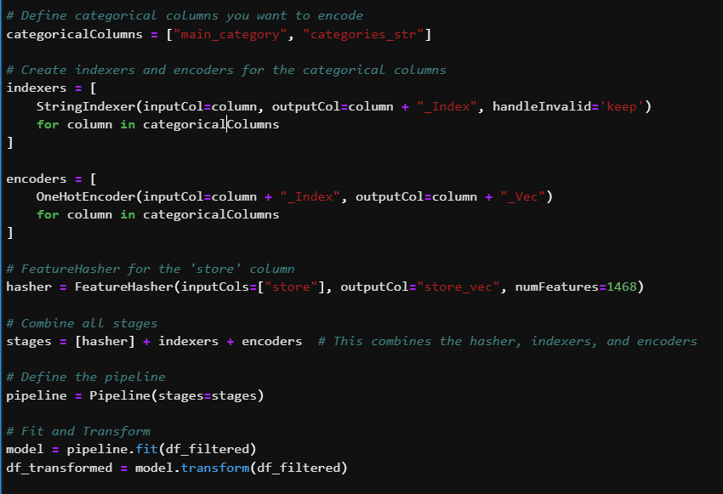
Feature Engineering
One hot encoded categorical strings like Store and Categories
Needed to use hashing on Store due to limitations in the Generalized Linear Regression Model

Slide 11
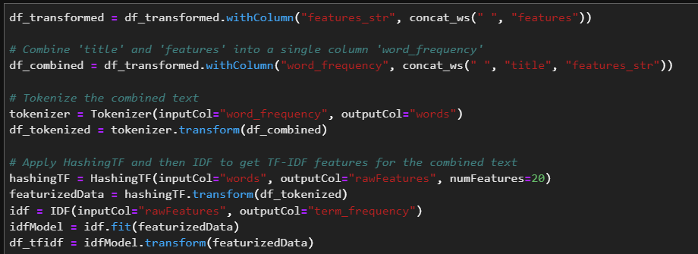
Feature Engineering
Combined descriptive features like Title and Features
Then used Term-Frequency Inverse Document Frequency

Slide 12
Overview of Modeling Pipelines Explored
Used Linear Regression as baseline
Tried Random Forest, Gradient Boosted Tree Regression, Generalized Linear Regression
Novel Approaches:
Tried normalizing the data
Used Tree-Structured Parzen Estimator (TPE) optimization for hyperparameter optimization
Through hyperparameter optimization, we realized the best parameters are elasticNetParam, regParam.

Slide 13
Experimental Results
Model | Train RMSE | Test RMSE
Linear Regression | 113.961 | 115.333
Random Forest | 114.817 | 135.849
Gradient Boosted Tree Regression | 139.123 | 140.614
Generalized Linear Regression | 128.699 | 134.895
Poor performance could be due to unbalanced and bad data

Slide 14
Key Findings
There was some information loss when using hashing on the Store column
This was done specifically for the GLR model, so could be removed in a real situation
For hyperparameter optimization, GridSearch and RandomSearch took too long; TPE optimization with the Hyperopt Package was our work-around
Hyperparameter optimization did not improve model performance
Linear regression → Highly nonlinear features
Other models → Need more/better data
Ultimately, further analysis needs to be performed
Better compute capabilities, better dataset, more time

Slide 15
Conclusion and Next Steps
Models have high error (RMSE > 100)
Pay for better cloud capabilities
Try different models and hyperparameters
Use more data
Try adding some user review information
Mainly the review text content, may be interesting to see if better reviews are correlated with higher prices

Slide 16
Open Issues
Ultimately, we were only able to use a small portion of the original dataset due to lack of compute
Lots of issues with cloud throughout the project
Cloud disconnecting during runtime, lack of collaboration capabilities
Pyspark version tied to dataproc, so you can’t update it easily
Models have high error, need to be trained on more data
Or find a better dataset

Slide 17
Thanks!

